Slide 1
Battle of neighborhoods
Analysis of Sushi Restaurants in New York

Slide 2
Introduction & Problem Description
Food plays a big role in New York. New York’s restaurants come in every size, style, price point, as well in every ethnic variety
PROBLEM:
Where should I open a new Sushi restaurant in New York?
What is the market vibe for Sushi restaurants in New York?
Which areas in New York have great Sushi restaurants? Which don’t?
Which is the best Sushi place in New York that I absolutely must try out?

Slide 3
Approach
Data Collection TO Data Exploration & Analysis TO Data preparation & preprocessing TO Data modeling
Data gathering and formatting: Download and explore New York City data by boroughs and neighborhoods.
Explore Neighborhoods in New York using the Four Square API to find all venues for each neighborhood.
Filter out and analyze each neighborhood for Sushi restaurants.
Find Rating, tips and like count for each Sushi Restaurant using the Foursquare API.
Sort and analyze the data based on Rating.
Visualize the distribution of ranking of neighborhoods for Sushi restaurants by boroughs using Folium library.

Slide 4
Data sources
New York city data that contains Boroughs and neighborhoods with their latitudes and longitudes.
Data source: https://cocl.us/new_york_dataset
This dataset will be used to explore neighborhoods of New York City.
Sushi Restaurants in New York
Data source: Foursquare API
We will use the Foursquare API to get all the sushi venues in New York
Geo space data
Data source: https://data.cityofnewyork.us/City-Government/tqmj-j8zm
This data will be used to plot New York borough boundaries on a choropleth map for visualization.

Slide 5
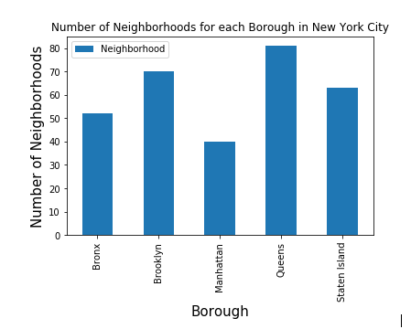
Results
There are 5 Boroughs and 306 neighborhoods across New York City.
Queens borough has highest number of neighborhoods.

Slide 6
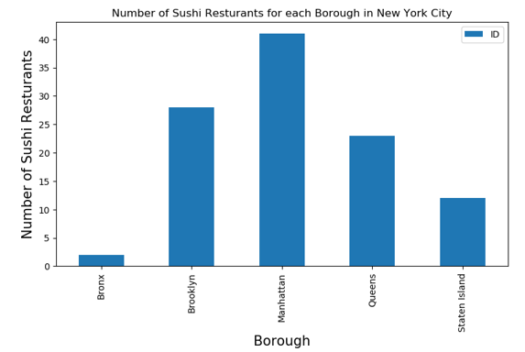
Data Analysis
There are 106 Sushi Restaurants within New York City.
Manhattan has the highest number of Sushi restaurants.

Slide 7
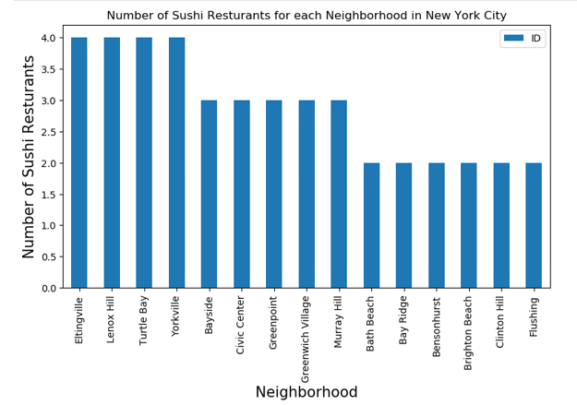
Comparative Study
4 neighborhoods – Eltingville, Lenox Hill, Turtle Bay and Yorkville all have 4 Sushi restaurants.
The maximum Sushi restaurants that a neighborhood has is 4

Slide 8
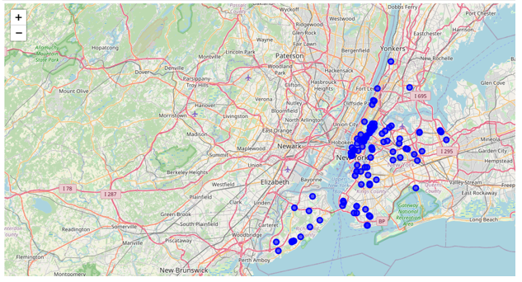
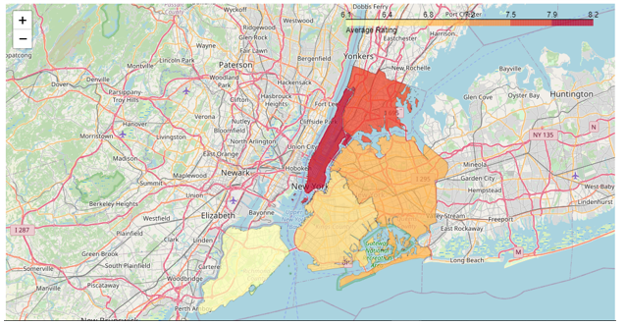
Sushi restaurants in New York
Sushi places appear relatively evenly distributed across New York with a concentration in Manhattan.
Popular areas of Sushi restaurants in New York from more to less: Manhattan, Bronx, Queens.

Slide 9
Ratings, likes and Tips
Restaurant with maximum likes is “Sushi Yasuda” in the “Manhattan” borough with 599 likes
Restaurant with maximum rating is “Sushi By Bou” in the “Manhattan” borough with a rating of 9.4
Restaurant with maximum tips is the “Sushi Yasuda” restaurant in the Manhattan borough with 260 tips.
Sushi restaurants in Manhattan followed by Bronx and Queens boroughs have decent average ratings and popularity.

Slide 10
Conclusion
You must absolutely try out “Sushi Yasuda” in the “Manhattan” area and let me know how you like it!
Manhattan, Bronx, Queens are decent locations for Sushi restaurants while Staten Island ranks last in average rating of Sushi restaurants.
Manhattan is the best place to stay if you want to have Sushi cuisine for Dinner!

